Slide 1
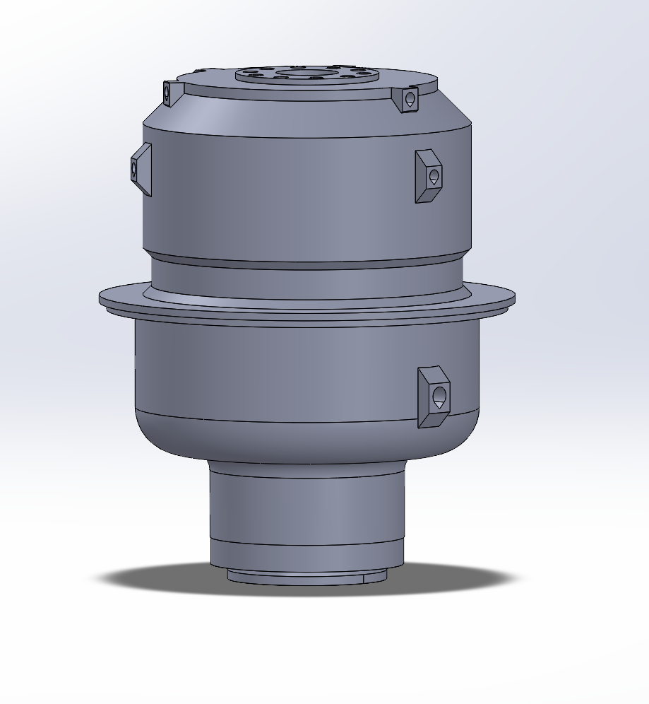
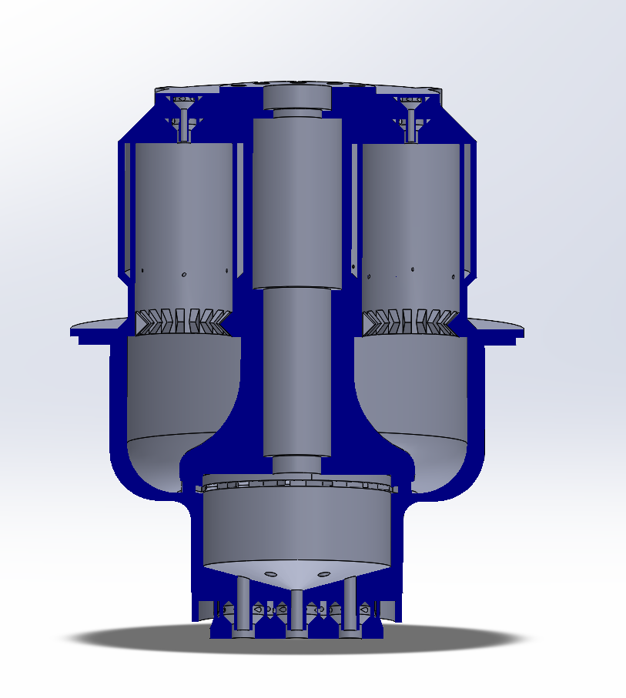
ASSEMBLY

Slide 2
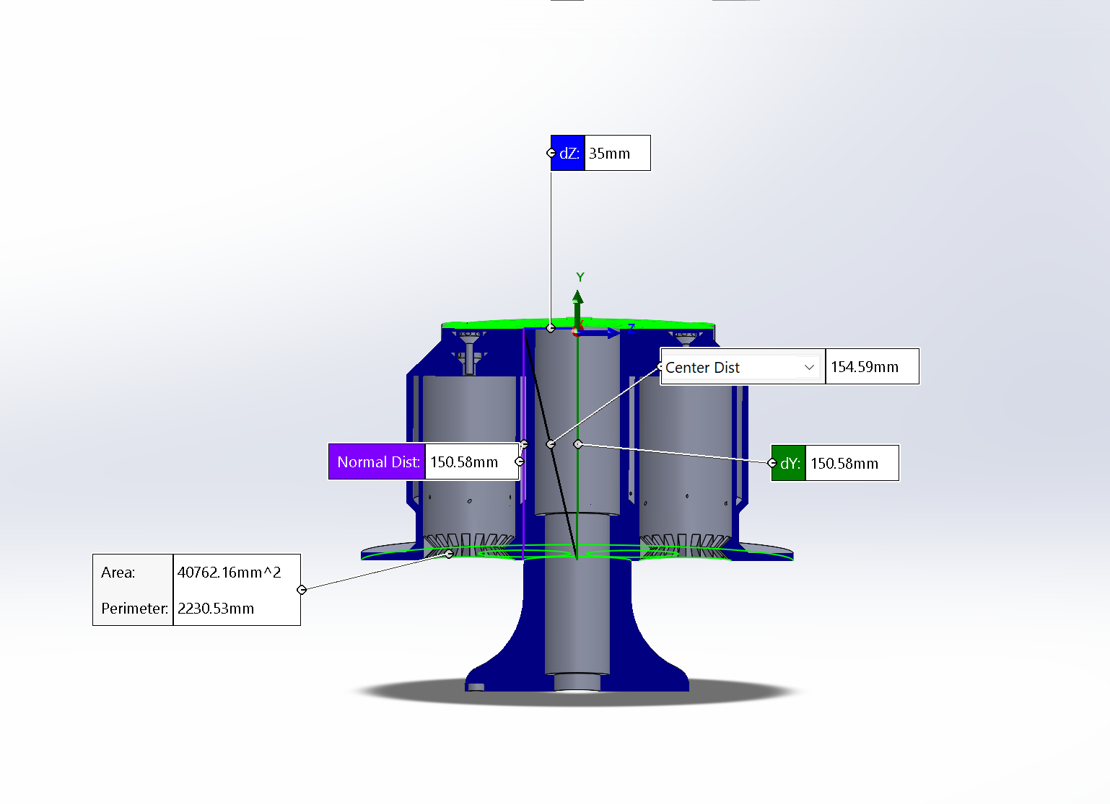
PreBurner
Additive: Inconel/Haynes
Welded assembly, lathe: Inconel/Haynes/Possible coat?
Is welding possible?

Slide 3
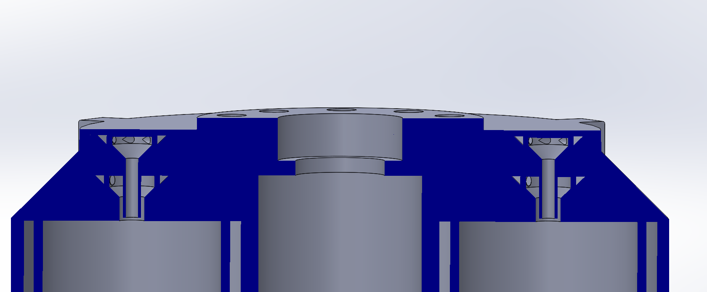
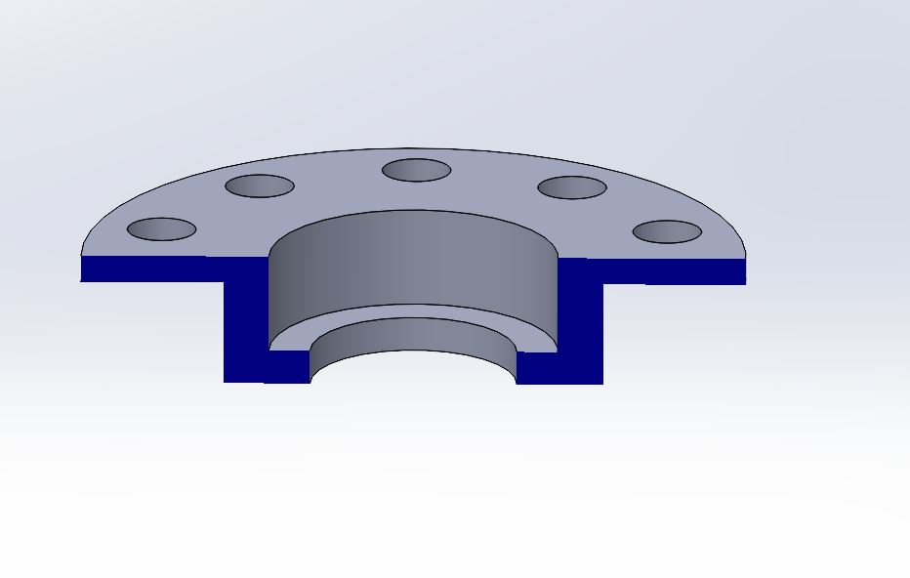
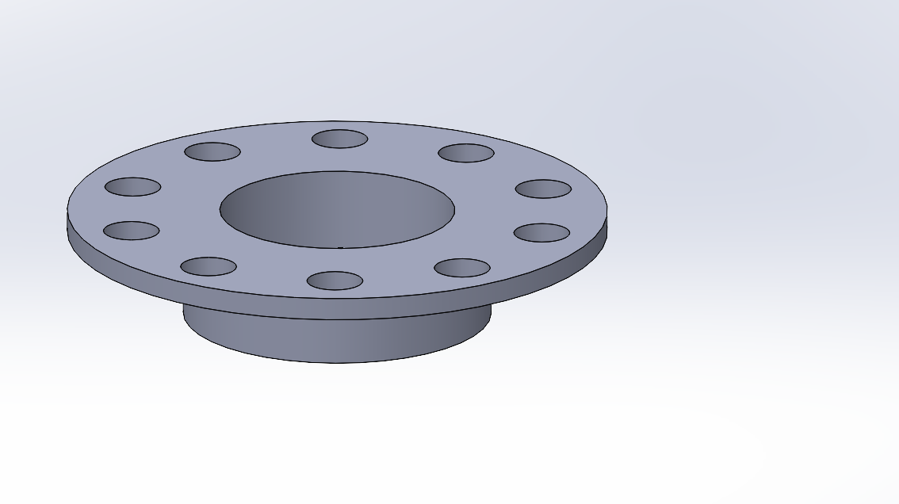
Bearing Housing
Lathe/CNC
Steel
Is this a good idea?

Slide 4
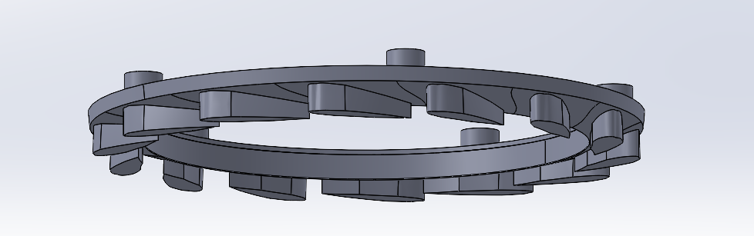
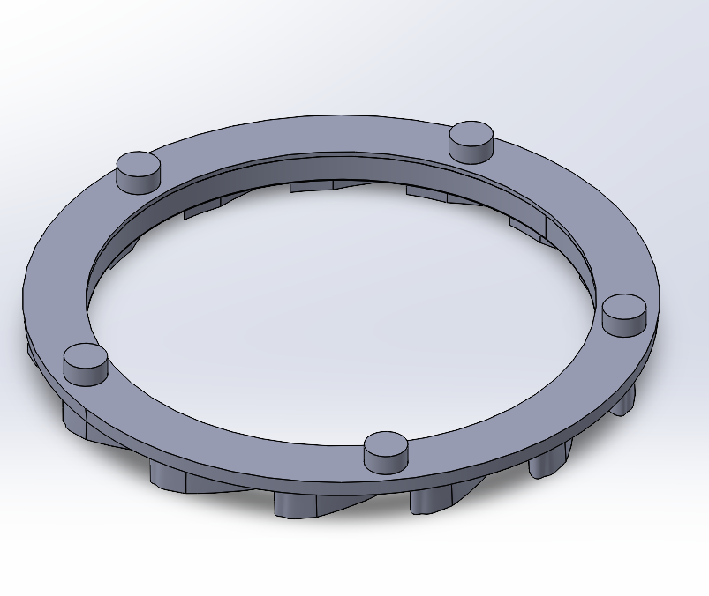
STATOR
CNC: inconel/haynes
:We want stator to be a interchangeable part so we can change turbine characteristics
Is this a viable way to connect? (interference/compression)

Slide 5
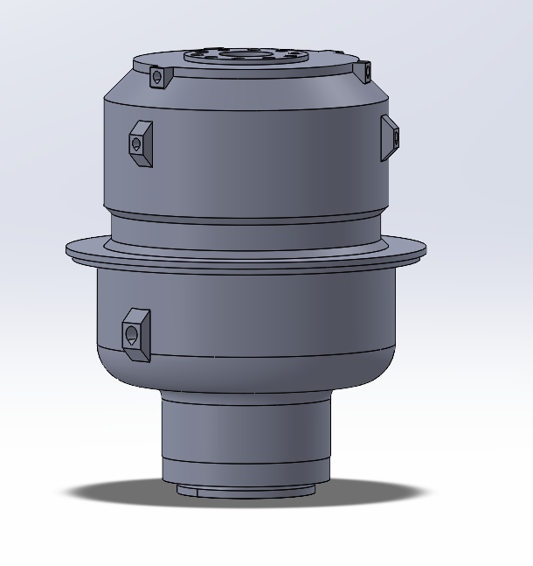
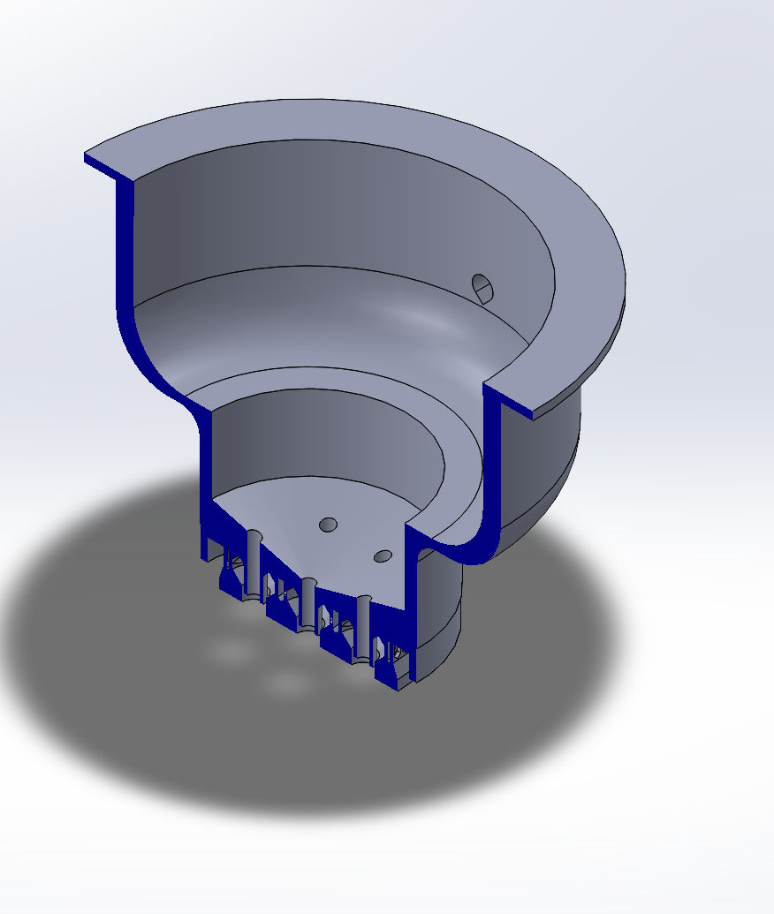
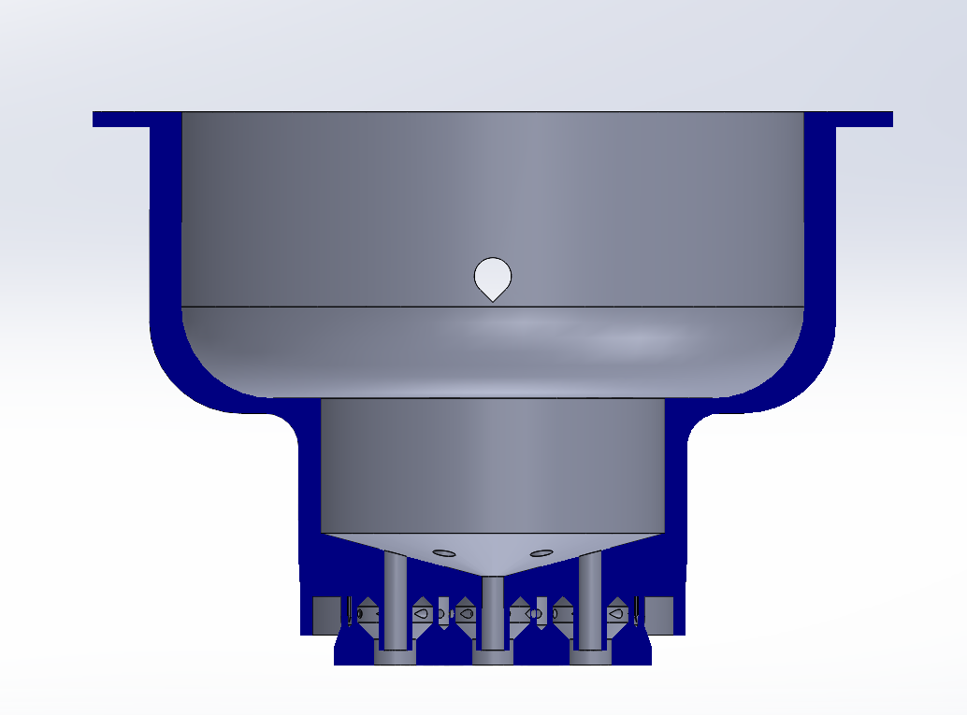
Turbine Housing/ Main injector plate
Idea: Is it possible to make this section out of steel and then coat the interior in inconel?
Reasons this might not work
:Wall heat melting the steel
:Inconel coat not thick enough to protect steel from GOX
Lathe?
Additive: Inconel/Haynes

Slide 6
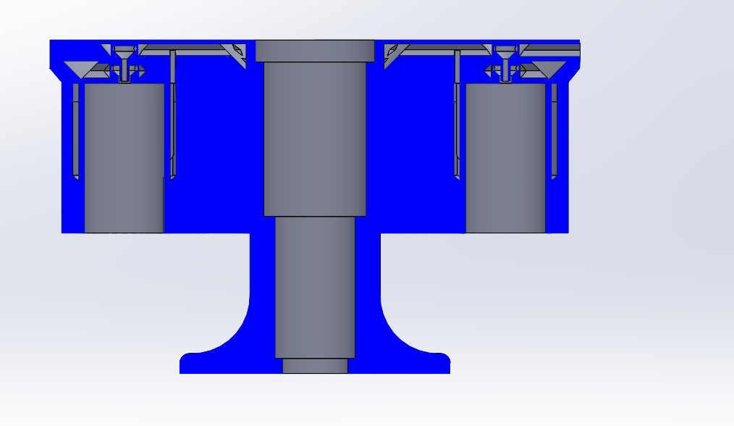
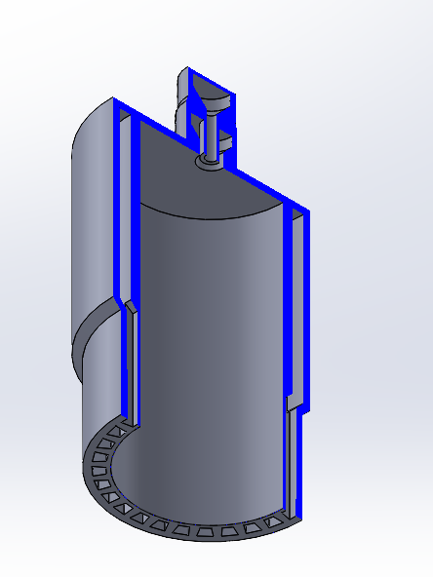
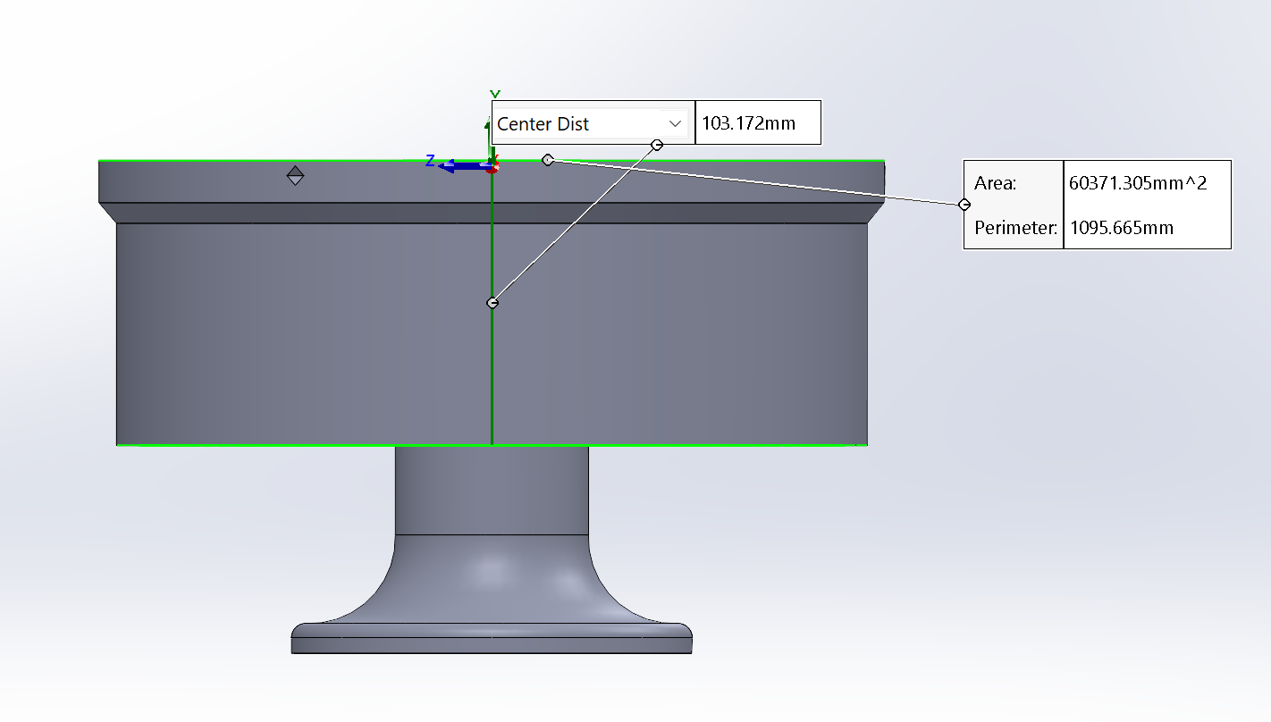
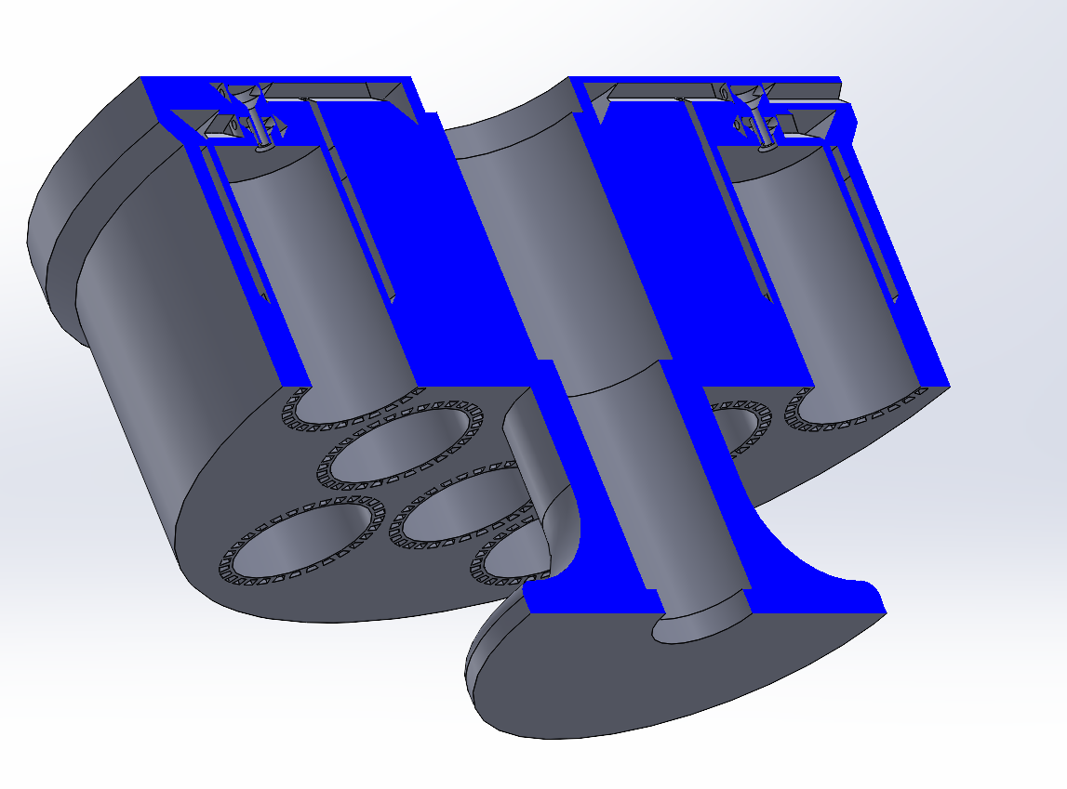
NEW SHORTER PREBURNER

Slide 7
Can this wall be 1 mm On coaxial swirl injector
:worried about porous walls
:pretty sure its fine tho cause its the same way the club has done these before

Slide 8
TO DO BEFORE MANUFACTURING
FINISH CAD/ANALYSIS (flange’s, seals, mechanical integration)
ANALYSIS (structural/thermal/acoustic sim, fatigue analysis, TEST INJECTOR DESIGNS)
DFM and gd&t
Budget
ROUGH TESTING FEASIBILITY PLAN (can we realistically build the test hardware or do we need to use professional setup)

Slide 9
Welding Info
Retired aerospace welder 125$ an hour
Aron Harshbager
937 510 5792
JSC Coating
https://www.ticonindustries.com/products/inc-alloy-625-filler-rod
Inconel to stainless filler rod 150$

Slide 10
Plating Info
https://haleperformancecoatings.com/contact-us/
Agreed to plate trunk free of charge

